Slide 1
TEAMDUTY-Web application

Slide 2
Overview
Introduction
Problem
Application Review
Solution
Tool & Technologies Review
System Architecture
Limitation
Deliverables
Project Milestone

Slide 3
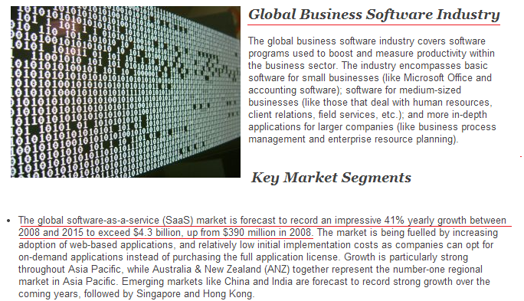
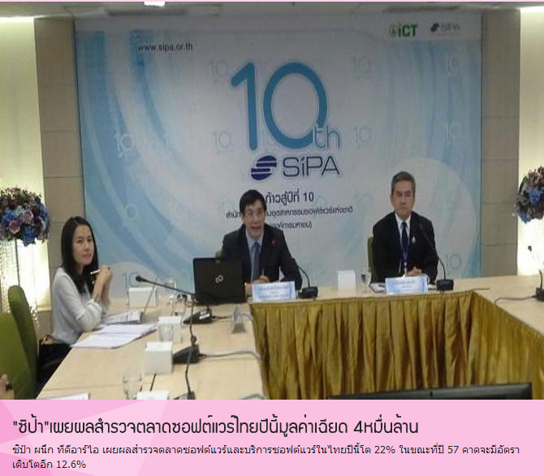
Introduction
Nowadays software industry plays an important role in the social and economic development of modern society.
http://www.reportlinker.com/ci02074/Business-Software.html
http://www.dailynews.co.th/Content/IT/193406/_%E0%B8%8B%E0%B8%B4%E0%B8%9B%E0%B9%89%E0%B8%B2_%E0%B9%80%E0%B8%9C%E0%B8%A2%E0%B8%9C%E0%B8%A5%E0%B8%AA%E0%B8%B3%E0%B8%A3%E0%B8%A7%E0%B8%88%E0%B8%95%E0%B8%A5%E0%B8%B2%E0%B8%94%E0%B8%8B%E0%B8%AD%E0%B8%9F%E0%B8%95%E0%B9%8C%E0%B9%81%E0%B8%A7%E0%B8%A3%E0%B9%8C%E0%B9%84%E0%B8%97%E0%B8%A2%E0%B8%9B%E0%B8%B5%E0%B8%99%E0%B8%B5%E0%B9%89%E0%B8%A1%E0%B8%B9%E0%B8%A5%E0%B8%84%E0%B9%88%E0%B8%B2%E0%B9%80%E0%B8%89%E0%B8%B5%E0%B8%A2%E0%B8%94+4%E0%B8%AB%E0%B8%A1%E0%B8%B7%E0%B9%88%E0%B8%99%E0%B8%A5%E0%B9%89%E0%B8%B2%E0%B8%99

Slide 4
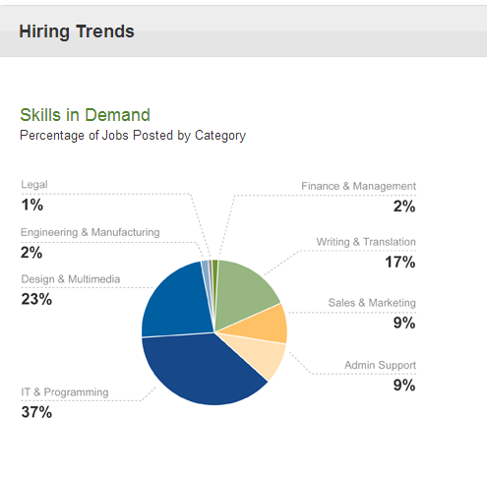

Introduction
In Software industry has increment number of employment the software freelancer
https://www.elance.com/q/online-employment-report

Slide 5
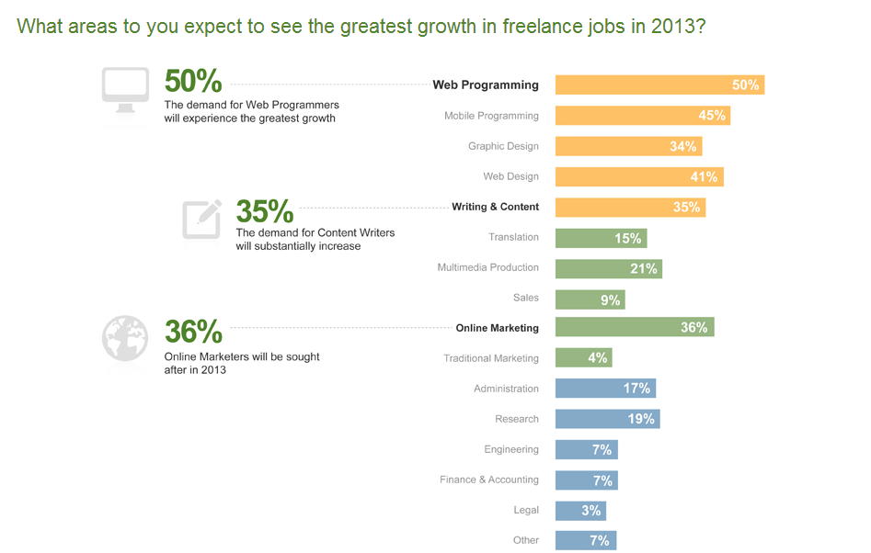
Introduction
growing of software freelance job
reference
https://www.elance.com/q/freelance-talent-report-2012

Slide 6
The scope
Other freelancer
manufacturing
Other work
software
Software freelancer
Sales
freelancer
legal
Legal freelancer
sales
job
Freelancer

Slide 7


Problems
Employer don’t know person who work as the software freelancer
Software – Freelancer want to find job that match with capability

Slide 8



Problems
“Software – freelancer spend a lot of time to find Software-project”
“Employer don’t know skill of Software – freelancer”

Slide 9


Problems
“Employer don’t know how far is project done”
“Less communication between employer and Software- freelancer ”

Slide 10
Application review
www.freelancer.com
Pros -There are many type of freelancer.
- freelance.com deals with all the documents meaning you save time
- The certification provides a guarantee for employer to employ the freelancer.
- largest online marketplace for freelance workers.
Cons
- Posting a job need some money depends on manner of task.
- To find project, only searching are allowed. - If the project is posted freelancer do not get inform.

Slide 11
Application review
www.108freelance.com
Pros
- update news about freelancer everyday
- have example document of resume and contract form - Free for register.
Cons
- 108freelance.com support only Thai language
- Very complicated register before using. - No communication via the web. - no tracking work.

Slide 12



Solution
- The application that help to gather employers and software freelancers.
- Identification the important detail and skill of software freelancer.

Slide 13


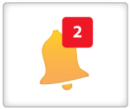
Solution
- Bidding the project help employer decide to select software freelancer.
- Notification on application to inform software freelancer

Slide 14



Solution
- Tracking progress of project to help employer know how far of work.
There are category about software to navigate the project

Slide 15


Solution
- Sending message is easy way to communicate via application .

Slide 16
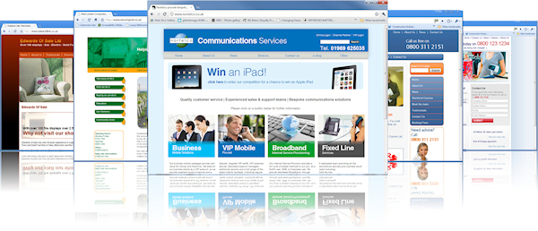
Solution
Website Application
why - Multiple Platforms - No need to install - Available 24 hours a day - Easy to use - C# programming language.

Slide 17
Objective
- To help the software-enterpriser(employer) find software-freelancer via web-application - To help the software-freelancer find project via web application
- To help the software-freelancer and software- enterpriser communicate via web-application

Slide 18




How our web is difference ?
Notification to software freelance
when project is posted.
There are category to navigate user.
Tracking work.
Send message via web application.

Slide 19

Tool & Technologies Review

Slide 20

Tool & Technologies Review

Slide 21
About MVC
architectural pattern separates an application into three main components: the model, the view, and the controller
Models. Model objects are the parts of the application that implement the logic for the application s data domain. Often, model objects retrieve and store model state in a database.

Slide 22
About MVC
Views. Views are the components that display the application s user interface (UI). Typically, this UI is created from the model data.
Controllers. Controllers are the components that handle user interaction, work with the model, and ultimately select a view to render that displays UI.

Slide 23

Quality Assurance
ISO 29110 for Very Small Entity (VSE)

Slide 24
Develop Model
Iterative Model

Slide 25
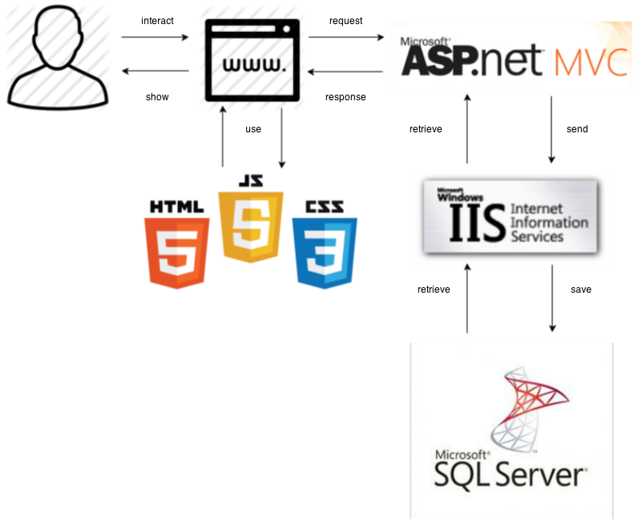
System Architecture
response
request

Slide 26
Limitation
- Internet connection is required for using web application.
- Web browser is required for using web application.
- User must be member before using web application.
- User will be using username in form email address to using in web application

Slide 27
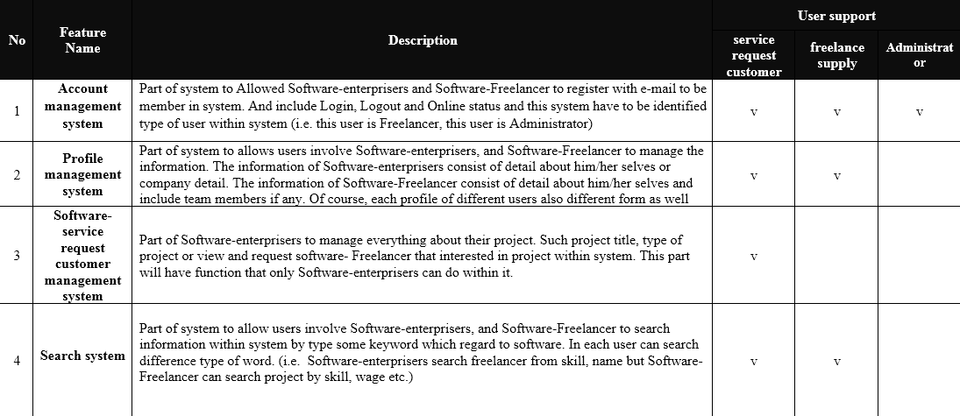
Deliverable

Slide 28
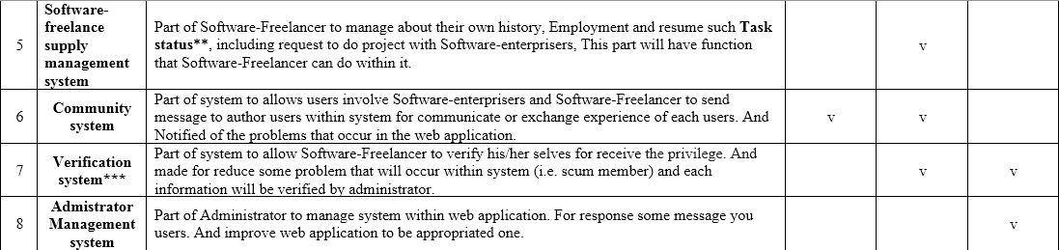
Deliverable

Slide 29
Deliverable
Milestone | Task | Milestone Criteria | Planned date
1 | Proposal | Topic defined | February
2 | Proposal | - Proposal reviewed - Proposal submitted - Proposal presentation | March
3 | Progress Report I | - Software requirement specification - Feature#1 - 2 - Feature designed - Test planned - Feature implemented - Feature tested - Progress report submitted - Progress report presentation | Mid May

Slide 30
Deliverable
Milestone | Task | Milestone Criteria | Planned date
4 | Progress Report II | - Feature# 3-5 - Feature designed - Test planned - Feature implemented - Feature tested - Progress report submitted - Progress report presentation | Mid July
5 | ShowPro | Overall of the system should be higher than 65%. | Beginning of September
6 | Progress Report III | - Feature#6-8 - Integrate and review all documents. - Integrate and review all documents. - Tests all features. - Reviews documents are completed. - Progress report submitted - Progress report presentation | End of September

Slide 31
Q&A

Slide 32
Appendix

Slide 33
Why MVC ?
- Division of work clearly
- Easy controllable
Separation of concerns (Systematically)

Slide 34

Tracking work
How employer tracking work

Slide 35
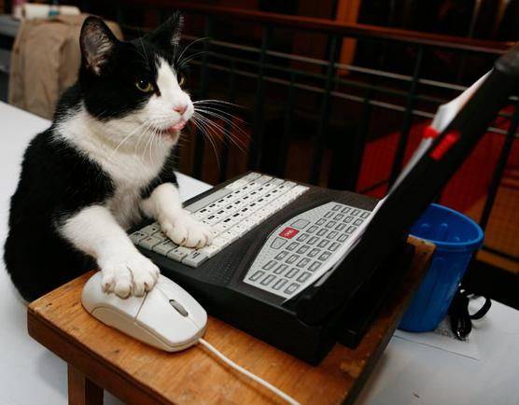

Tracking work
1. Employer need to post project first
2. Bidding project

Slide 36



Tracking work
3. Select freelancer that bidding
on project
4. Freelancer that selected will be shown in list

Slide 37
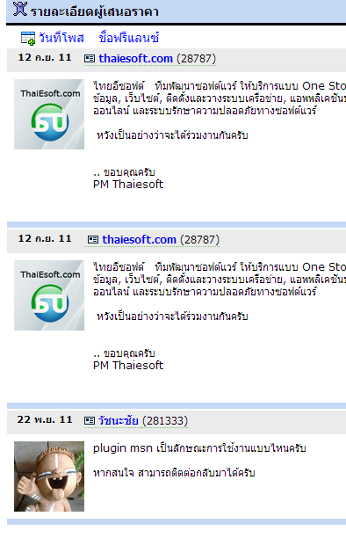



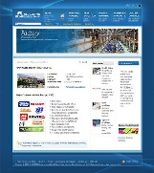
Tracking work
5. Start project
6 . Communication inside project
How about work ?
Can you show me some?
employer
freelancer
I’m implement about user interface
Very good. Fight :)
employer

Slide 38


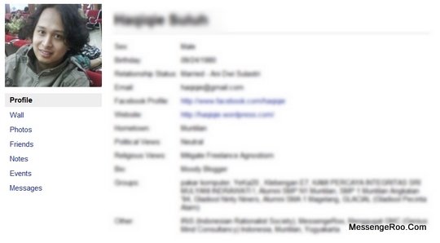
7 . If project is done employer can closed project.
8. After closed project will be shown on freelancer.
Software freelancer
- Need someone to create website.
- Development with android.
Achieve project

Slide 39
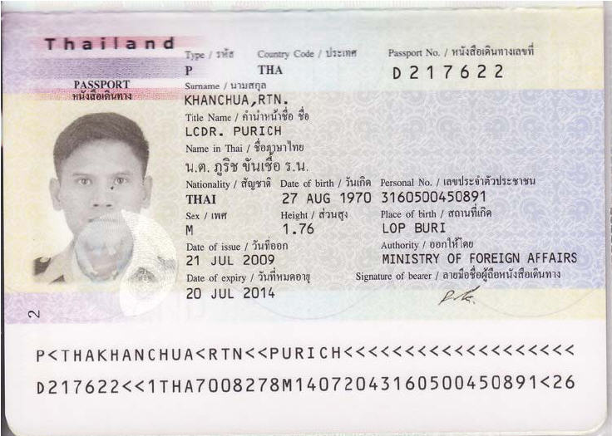

Verification system
*** For verify system, the freelancer have to attach the Thai National ID card’s image (with the fixing side and size (not identify yet)) then admin will verify that the image is Thai people or not, for the foreigner could use passport’s image. About the enterprise don’t need to verify because you can check that the enterprise is fake or not you just can find them form address they input.

